Slide 1
Memory Error Detection in Security Testing
Nasif Imtiaz, Laurie Williams
North Carolina State University
RunSafe Security

Slide 2
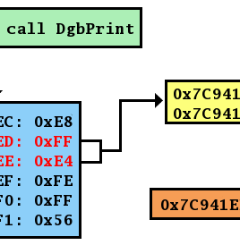
Memory errors are prevalent: during and after security testing

Slide 3
Research Questions
How frequently memory-related alerts are identified by a security tool? How do developers respond to these alerts?
How many CVEs were identified by a security tool when the involved flaws were first introduced in the code?

Slide 4
Data Sources
Extension of Coverity dataset from our prior work
Imtiaz, Nasif, Brendan Murphy, and Laurie Williams. "How Do Developers Act on Static Analysis Alerts? An Empirical Study of Coverity Usage." 2019 IEEE 30th International Symposium on Software Reliability Engineering (ISSRE). IEEE, 2019.
CVE dataset from NVD
Collected patch commits for Linux CVEs

Slide 5
Coverity Dataset
Coverity scan reports for ten C/C++ projects from past years with scan interval less than a week
We can identify an alert was first detected and when it was eliminated
We track back to commits made on the affected files to determine if developers made any code change to fix an alert (i.e. actionable)
We also have developer feedback from Coverity data if alerts were marked as a Bug, Intentional, or False Positive
We calculated lifespan and fix complexity for the actionable alerts

Slide 6
Projects with historical Coverity scan reports

Slide 7
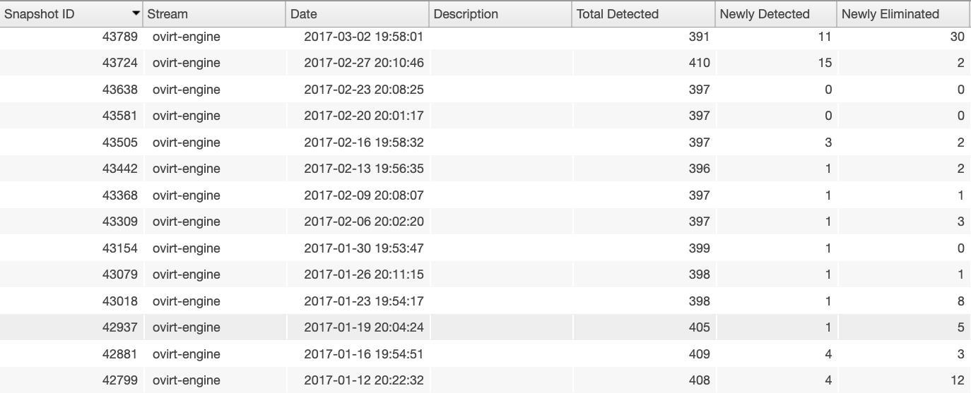
Analysis history on Coverity database

Slide 8
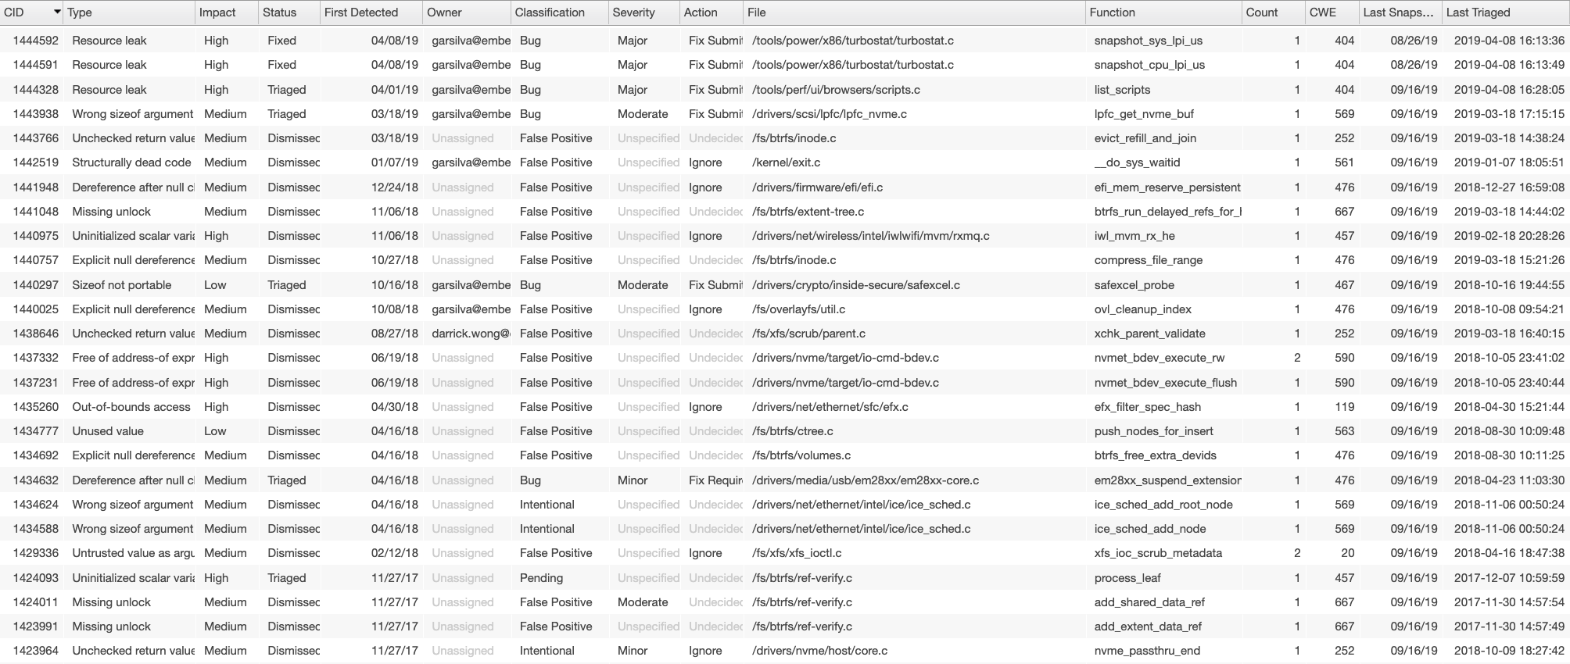
Alert history on Coverity database
Unique alert id, alert type, severity, status (fixed/dismissed/new), date when first detected, a classification given by the developers (e.g. bug/false positive or unclassified by default), file location, date when last detected

Slide 9
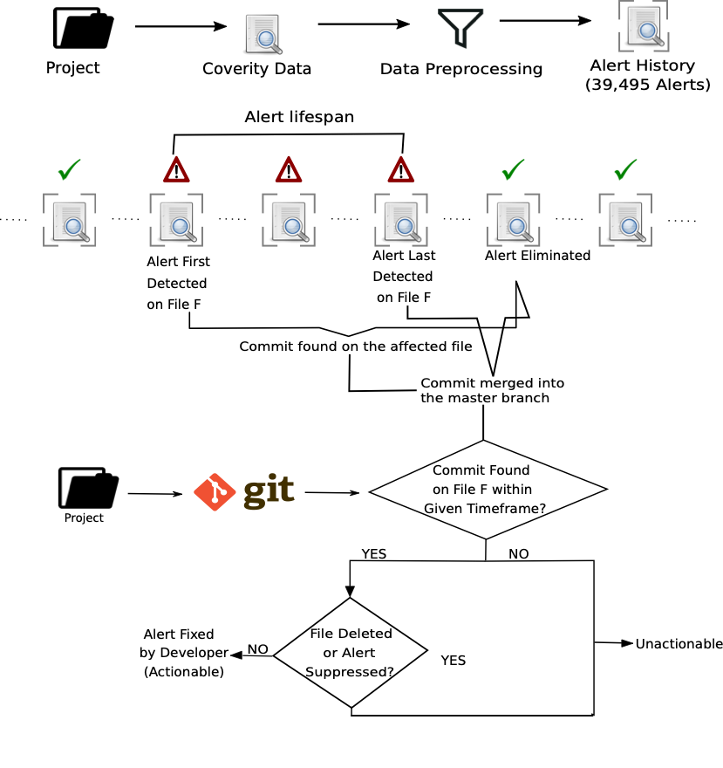
How do we determine actionability and lifespan?

Slide 10
CVE dataset
Pulled CVEs for the projects in Coverity dataset between first and last scan
Collected patch commits for Linux CVEs

Slide 11
CWE (Common Weakness Enumeration) classification
Both Coverity alerts and CVEs are mapped with CWE ids
161 distinct CWE ids
Two reviewers independently classified CWE ids as memory vs non-memory
Discussion upon initially disagrees CWE ids to come to a final classification
Kohen’s Kappa agreement rate 0.79
43 (26.7%) were classified as memory-related

Slide 12
Findings:
How frequently memory-related alerts are identified by a security tool? How do developers respond to these alerts?

Slide 13
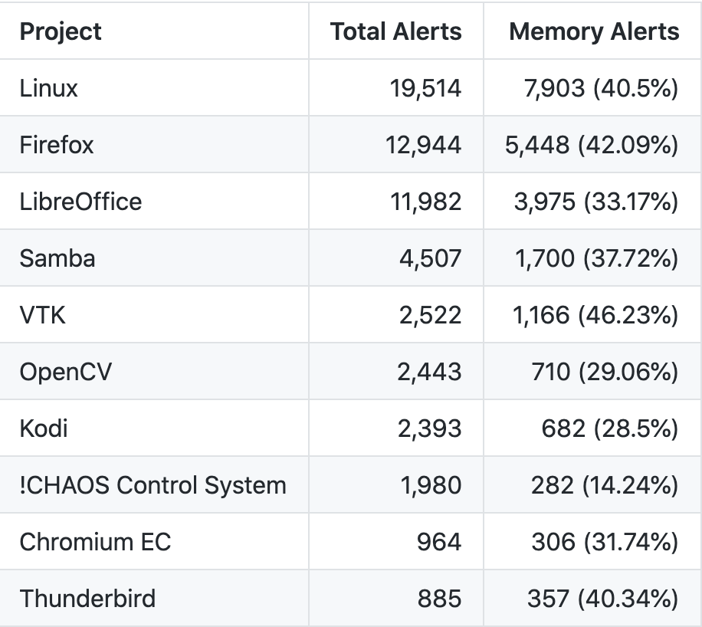
To what extent do memory related alerts appear when C/C++ projects are scanned by Coverity?
Approximately one-third of Coverity alerts were found to be memory related (35.4%)

Slide 14
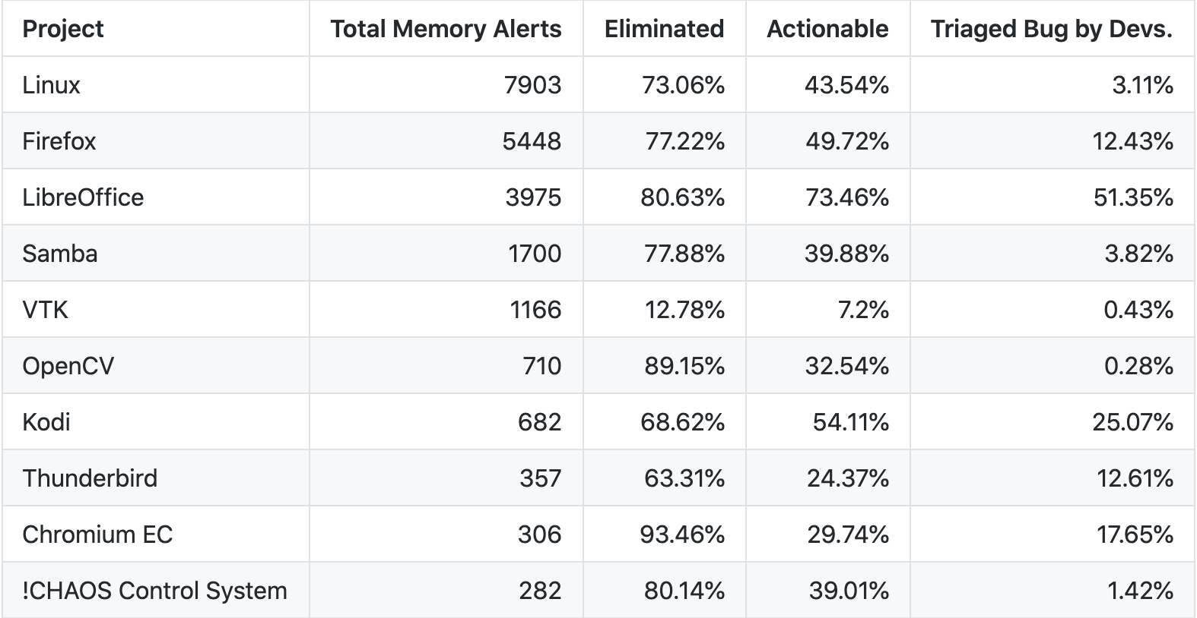
What percent of memory related alerts are actionable (i.e. acted on by developers)? What percent of memory related alerts were marked as false positives by the developers?
Memory alerts are rarely liked to be intentional coding by developers (0.8%)

